Slide 1
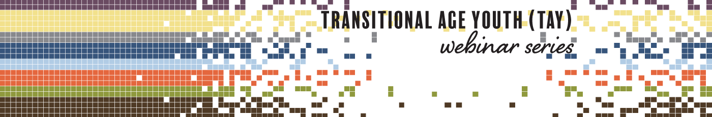



Substance Use Disorders:
Appreciating the Challenges of Minority Youth
Produced in Partnership by:

Slide 2




Produced in
Partnership
attcnetwork.org
amersa.org
sbirt.webs.com
Notes:
Ask questions at any point through the “Chat” pane of your zoom Control Panel on your computer or mobile device.
Answers will be posted on the website.

Slide 3
The Impact of Substance Use on the Developing Adolescent Brain
Who's Doing What? The Epidemiology of Adolescent Substance Use
Substance Use Interventions for Adolescents and Transitional Age Youth
Integrating Stigmatized Loss and Disenfranchised Grief into the SBIRT Model
Substance Use in Adolescents and Transitional Age Youth: Justice Involvement and Homelessness
Substance Use Disorders: Appreciating the Challenges of Minority Youth
amersa.org/resources/tay-webinar-series

Slide 4


Webinar Presenters
Kevin M. Simon, MD Child and Adolescent Psychiatry Fellow
Boston Children's Hospital, Addiction Medicine Fellow, Boston Children's Hospital, Clinical Fellow in Psychiatry Harvard Medical School
Hoover Adger, Jr., MD, MPH, MBA
Professor of Pediatrics, Division of Adolescent & Young Adult Medicine, Faculty Co-Leader, Sabin College, Johns Hopkins School of Medicine

Slide 5
Disclosures
Dr. Adger has no conflicts of interest to disclose.
Dr. Simon has no conflicts of interest to disclose.
Notes:
Ask questions at any point through the “Chat” pane of your zoom Control Panel on your computer or mobile device.
Answers will be posted on the website.

Slide 6
Outline/Objectives
• Describe the epidemiology of substance use disorders (SUD) and the impact on children and families.
• Discuss racism as a factor affecting health outcomes.
• Discuss health disparities and opportunities for enhancing outcomes in the prevention, intervention, and treatment of adolescents affected by substance use (SU) and SUDs.

Slide 7

Clinical Case
12-year-old Black boy with Type I Diabetes
Multiple hospitalizations for DKA
Parent and child sent to intensive educational program
Admissions for new onset seizures and hypoglycemia
Parental/family history
What is the secret to this problem?
Notes:
In my role as a new primary care provider and adolescent health specialist in the department of pediatrics, I inherited a 12-year-old patient from a departing Endocrinologist who had insulin dependent diabetes. He had a stack of hospital records that was a tall as me. He had an interesting history of multiple admissions to the hospital and despite that fact of his multiple admissions, everyone in the institution was enamored by him. He was engaging and bright and seemed to have a lot going on for himself. As his primary care provider, my role was to fix him. I have since learned that I cannot, and it is not my role to fix anybody. This is the fallacy of the heuristic of the medical model that teaches us that when we identify a problem that it is our job to fix it; and to fix it right now. I have learned that the only ones who can actually do that, are my patients and/or their families. However, my initial assessment as his primary care provider was that he simply did not know enough about diabetes, so I sent him and his family off to a one-week residential diabetes education experience. I assumed that I had discovered the royal fix for this patient, and all seemed well for about the next 3-6 months. Then, he was back in the hospital admitted with DKA. Over the next several months he had several admissions and I was feeling like a total failure. Another 3-4 months went by and now he was admitted to the with a drastically new and different picture. He was admitted with seizures and documented hypoglycemia and a blood sugar of <20. He was seen by Neurology and Endocrinology and a bunch of other specialists and had a lot of fancy studies and imaging. They all had interesting theories in the etiology, but no one had any answers to the puzzle. So, when one is stuck, and it is not clear what you are dealing with, what are we taught to do? Yes, start at the beginning and take a good history.
So, I sat down with the patient and took a complete history including a family history and social history and used my curiosity to learn about the patient as an individual within his community and through the inquiry out popped the secret. Any Guesses as to the secret?
The patient had been diagnosed with DM at the age of two and the mother was the person who administered the insulin. The problem was that the mother had an interesting condition called alcoholism that none of the previous care providers, nor myself, were aware of. And depending on how intoxicated she was and how blurred her vision was she either pulled up too much or too little insulin. So as the pediatrician, I intervened, with the mother on behalf of the child and assisted the mother in getting into treatment for her alcohol use disorder. I subsequently had the opportunity to follow this same patient for an additional 10 years and over the next 10 years of following this young man how many admissions do you think that he had to the hospital? He had not a single admission to the hospital. My interventions were to monitor his blood sugar and if there seemed to be an alteration in his control that was a signal to touch base with his mother to ensure that she had the support network that she needed to maintain her sobriety and recovery. My lesson from this was that this patient like so many other children was suffering in silence and that in order to be a good physician, I needed to know more about the disease of addiction, substance use and substance use disorders.

Slide 8
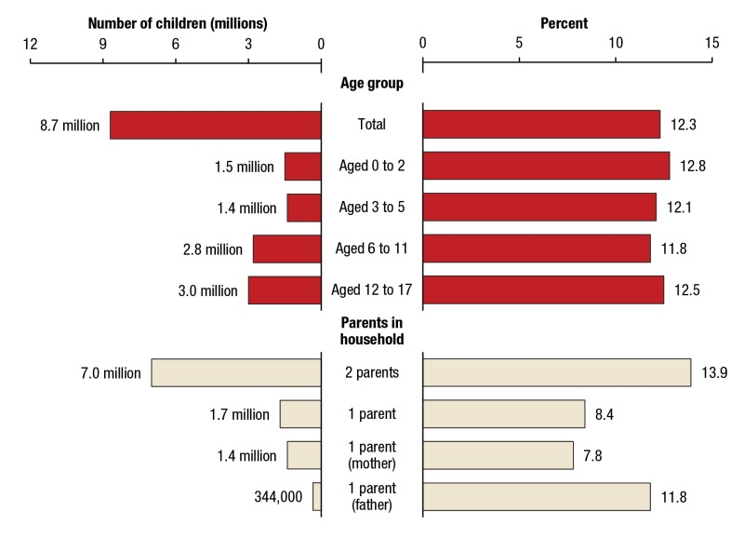
Epidemiological Issues: How Many Children/Adolescents are Affected by Family SUD?
Number and percentage of children aged 17 or younger living with at least one parent with a past year substance use disorder, by age group and household composition: annual average, 2009 to 2014
Source: SAMHSA, Center for Behavioral Health Statistics and Quality, National Surveys on Drug Use and Health (NSDUHs), 2009 to 2014.
Notes:
The epidemiology of this health problem is staggering. It is estimated that there are some 20 million individuals in the US with a past year history of a substance use disorder. Oddly less than 10% of individuals who need or could benefit from treatment receive it. And even more disturbing is the reality that less than 10% of those who do get to treatment are referred there by a physician.

Slide 9
National Longitudinal Alcohol Epidemiologic Survey - 1992
7.4% of adults classified with DSM-IV* alcohol use disorder in past year.
18% of adults classified with lifetime DSM-IV alcohol abuse or dependence.*
9.7 million children living in households with 1 or more adults who were abusing or dependent* on alcohol
*DSM-5 no longer recognizes abuse or dependence, but categorizes substance use disorders into levels of severity (mild, moderate, and severe).
B F Grant, AJPH; 90 (1):112-115; 2000
Notes:
As a pediatrician I am aware of the fact that the point prevalence of alcohol use disorders in the US is somewhere in the neighborhood of 5-7 %; with a lifetime prevalence of 15-18%, which translates into just under 10 million or 1 in every 4 children in the US living in households with 1 or more adults who are affected by an alcohol use disorder. (B F Grant, AJPH; 2000.

Slide 10
National Longitudinal Alcohol Epidemiologic Survey - 1992
1 in every 4 children in the US exposed to alcohol abuse or dependence in the family.
The number “defines one of today’s major public health problems.”
“Children exposed through no fault of their own…are thrust into families and environments that pose extraordinary risks to their immediate and future well-being and threaten the achievement of their fullest potential.”
B F Grant, AJPH; 90 (1):112-115; 2000
Notes:
As a pediatrician I am aware of the fact that the point prevalence of alcohol use disorders in the US is somewhere in the neighborhood of 5-7 %; with a lifetime prevalence of 15-18%, which translates into just under 10 million or 1 in every 4 children in the US living in households with 1 or more adults who are affected by an alcohol use disorder. (B F Grant, AJPH; 2000.

Slide 11
Addiction a Pediatric Disease: > 90% of adults with a SUD began use during adolescence
Notes:
Volkow ND, Koob GF, McLellan AT. Neurobiologic Advances from the Brain Disease Model of Addiction. N Engl J Med. 2016;374(4):363-371. doi:10.1056/NEJMra1511480

Slide 12
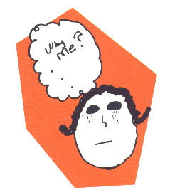
Oddly, the majority of Children/Adolescents in families affected by addiction go undetected.

Slide 13
Children of Parents or in Families Affected by SUDs
Higher risk for SU/SUD related problems than other children.
Family interaction is often defined by SUD in a family.
A relationship between parental SUD and child abuse has been documented in a large proportion of child abuse and neglect cases.
Higher risk for placement outside the home.
Exhibit symptoms of depression and anxiety more than do children from non-affected families.
More physical and mental health problems and higher health and welfare costs compared to children from non-affected families.
Higher rate of behavior problems.
Score lower on tests measuring school achievement and exhibit other difficulties in school.
Maternal SU during pregnancy associated with adverse outcomes or neurological deficits.
May benefit from supportive adult efforts to help them.

Slide 14
Primary roles of the Family in the Social and Cognitive Development of Children
Two relevant conclusions from the literature:
All familial variables that can, will affect child outcomes
The parent-child interaction is characterized primarily by two major dimensions:
  Nurturance (i.e., warmth and support)
  Control (i.e., supervision and discipline)

Slide 15
Children of Parents Affected by SUD
May lack consistency, stability, or emotional support due to chaotic family environment.
May be physically and emotionally traumatized due to accidental injury, verbal abuse or physical abuse due to parental drinking/drug use.
May encounter:
  Poor communication
  Permissiveness
  Violence
  Neglect
  Undersocialization

Slide 16
Family Disease Model: The SUD Family System
Rigid Rules
Rigid Roles
Don’t Talk
Disease of Addiction
Don’t Trust
Defense Mechanisms
Don’t Feel
Isolation

Slide 17
Definitions:
Terms to know

Slide 18
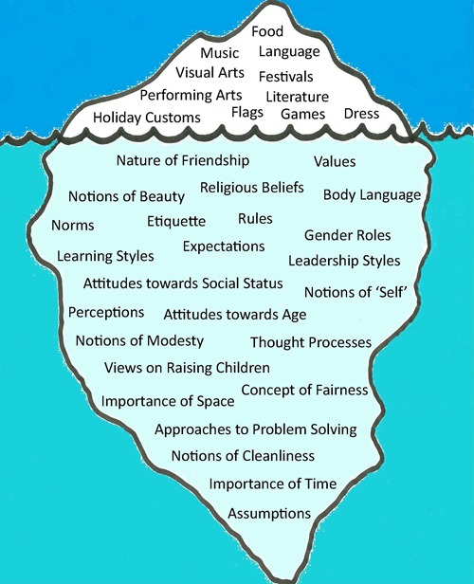
Iceberg Theory of Culture
A society’s culture includes aspects that are visible (the 10% seen above the water level), as well as a target portion that is hidden beneath the surface.
Notes:
I want to center this talk on the iceberg theory of culture. Society’s culture is like that big iceberg in the ocean with a small portion that is visible above the water level as well as a larger portion that is hidden beneath the surface. So when we view culture and people through this lens, we can start to understand why while we can only see the 10% of a person or community, we judge or make assumptions based on the 90% we can’t see below the waterline as this is what influences the top 10%. I will be coming back to this concept throughout the presentation as our task in reducing health disparities is to uncover and what lies below the surface.

Slide 19
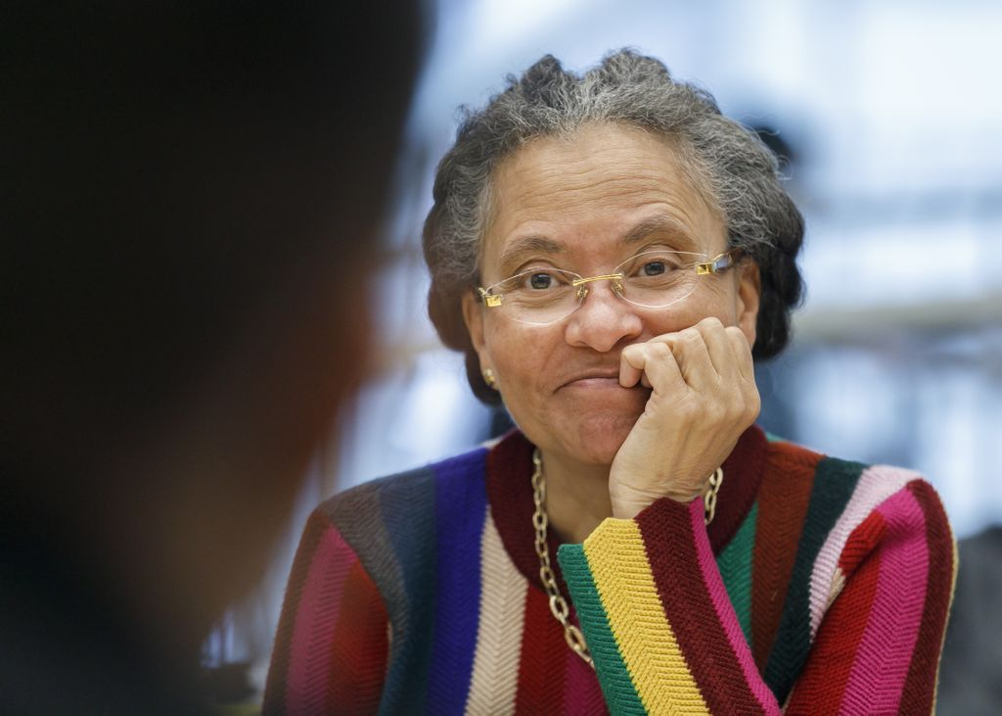

Racism & Antiracism:
Racism
“System of structuring opportunity and assigning value based on the social interpretation of how one looks (‘race’) that unfairly disadvantages some individuals and communities…and saps the strength of the whole society through the waste of human resources.”
- Camara P. Jones, MD, MPH, PhD
Anti-Racism
“Explicitly expressing the idea that racial groups are equals, actively opposing racism, and supporting policy that reduces racial inequity.”
- Ibram X. Kendi, PhD
Camille Robinson, MD, MPH
Notes:
Racism is a system that structures opportunities and assigns value based on race, which is a social construct. This system unfairly disadvantages some communities and advantages other communities with an ending result of affecting the whole society

Slide 20
Historical Context:
Political and Legislative History to know

Slide 21
Historical Context in the US:
Historical injustices setting the stage for persistent injustices and disparities
US banned importation of African slaves
Emancipation Proclamation & 13th Amendment
1790
1830s
Beginning of slavery in the US
1619
1808
1863 & 1865
Naturalization Act
Indian Removal Act & Trail of Tears
Adapted from Camille Robinson, MD, MPH
Notes:
We start in 1790 with the Naturalization Act which made it so that US citizenship was restricted to free whites
1619 was the beginning of slavery in the US with the first 20 Africans brought to Jamestown, VA.
It wasn’t until 1808 that the US banned importation of African slaves but slavery was still legal
While slavery was ongoing and the US wanted to expand, President Andrew Jackson signed the Indian Removal Act which led to the forced removal of Native American tribes from their lands and approximately 4,000 Cherokees died on this forced march, which became known as the "Trail of Tears.” This was one of the most fundamental injustices to have occurred to the Native American people that has lasting impacts today. Then about 250 years after the start of slavery in the US, President Abraham Lincoln signed the Emancipation Proclamation followed by passing of the 13th Amendment abolishing slavery in the US.

Slide 22
Historical Context in the US:
Historical injustices setting the stage for persistent injustices and disparities
Harrison Narcotics Tax Act
1896
1930 – 1950s
1914
Plessy v. Ferguson
HOLC Redlining Maps & Federal Housing Act
Marihuana Tax Act
Jim Crow Era
Adapted from Camille Robinson, MD, MPH
Notes:
After the abolishment of slavery, Jim Crow laws were enacted in the South. These Jim Crow laws were legal policies and laws that enforced racial segregation. In hospitals, this looked like having “coloreds only units” and “whites only units or hospitals”. 30 years later, the landmark Plessy v. Ferguson Supreme Court case upheld the constitutionality of these racial segregation laws for public facilities as long as the segregated facilities were equal in quality^{[2]} – a doctrine that came to be known as "separate but equal”. This occurred despite overwhelming evidence that facilities for black communities were not equal in quality. In the 1930-1950s the federal government's Home Owners' Loan Corporation created city maps that assigned grades to residential neighborhoods that reflected their "mortgage security" that would then be visualized on these color-coded maps. Neighborhoods receiving the highest grade of "A"--colored green on the maps--were deemed minimal risks for banks, mortgage lenders, and develops when they were determining who should received loans and which areas in the city were safe investments. Those receiving the lowest grade of "D," colored red, were considered "hazardous.” The color of these hazardous neighborhoods how the maps got their redlining name as redlines were literally drawn around black neighborhoods as neighborhoods with communities of color overwhelmingly received D grades.

Slide 23
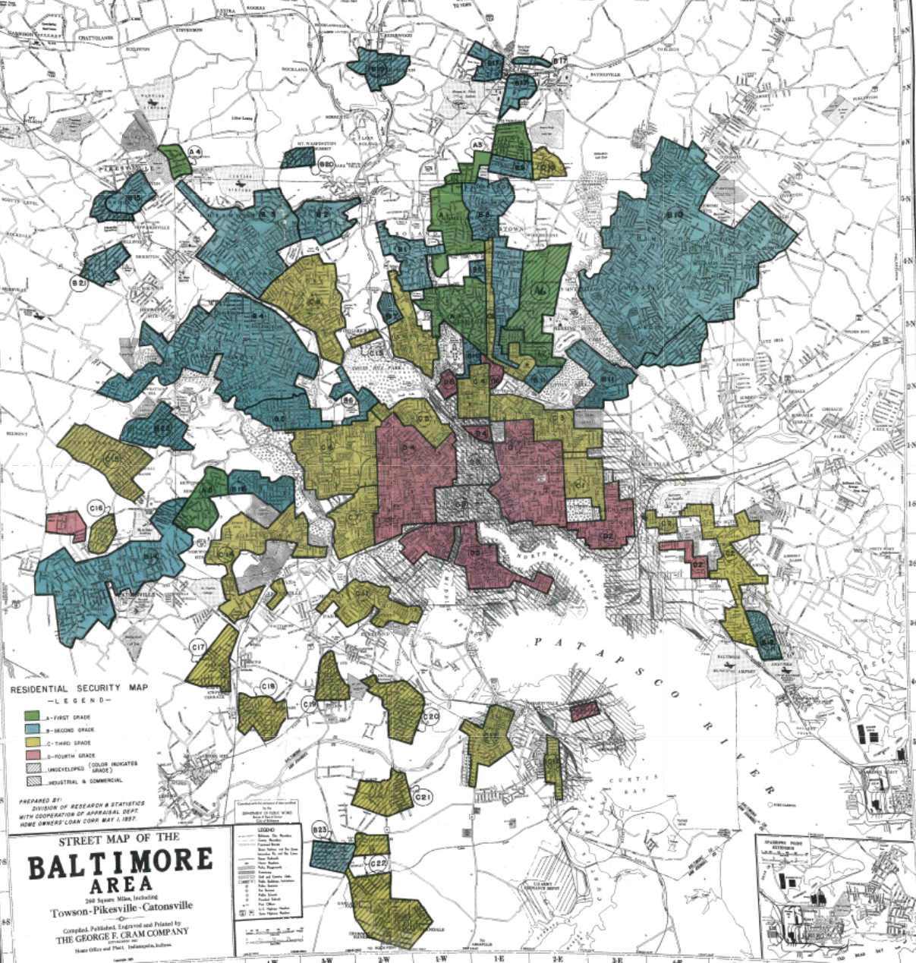
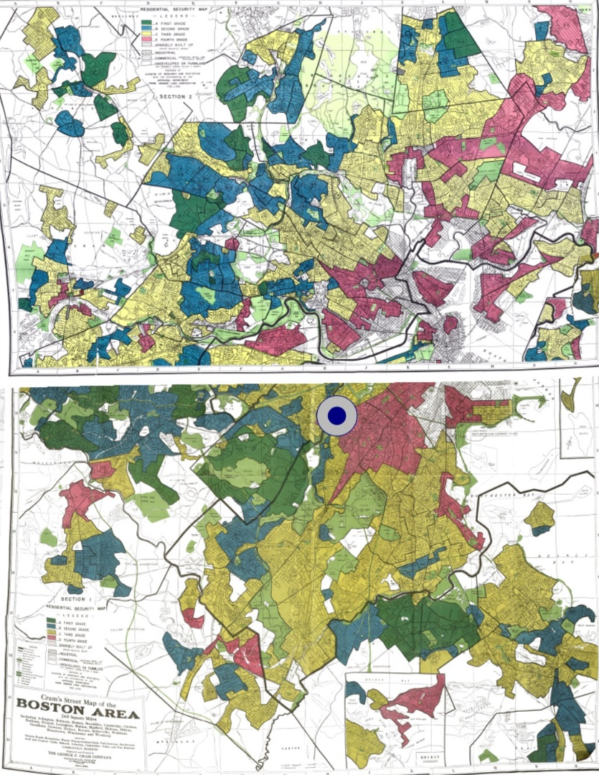
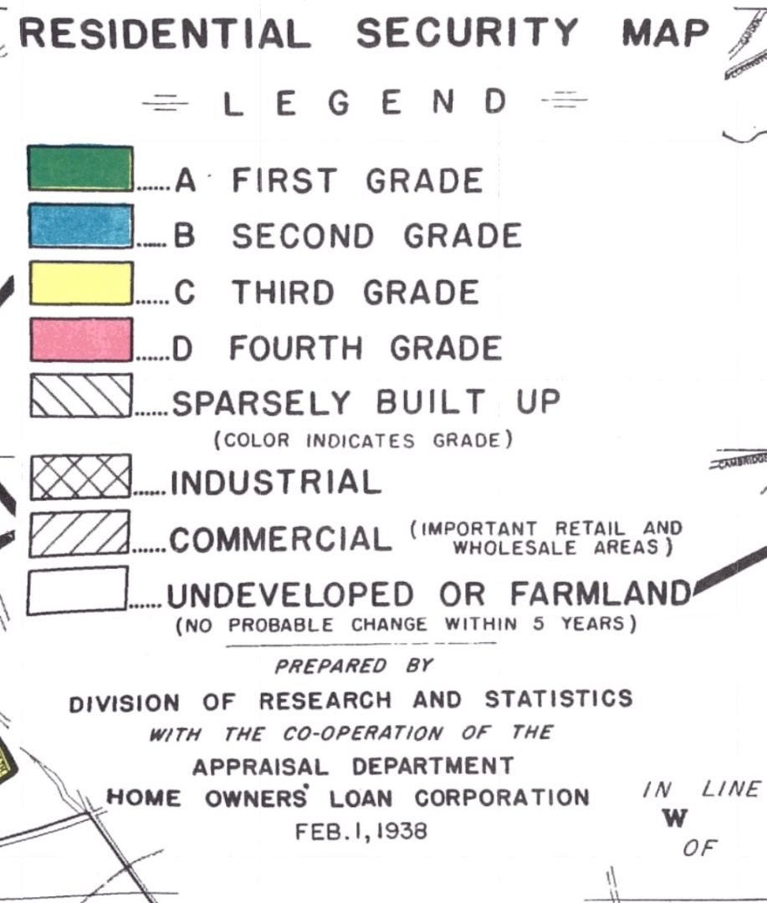
Redlining Map:
University of Richmond’s Digital Scholarship Lab. Mapping Inequality: Redlining in New Deal America. Available at https://dsl.richmond.edu/panorama/redlining/

Slide 24
Historical Context in the US:
Historical injustices setting the stage for persistent injustices and disparities
Tuskegee Study of Untreated Syphilis in the Negro Male
Harrison Narcotics Tax Act
1896
1930 – 1950s
1951
1932-1972
1914
HOLC Redlining Maps & Federal Housing Act
Henrietta Lacks Unknowingly Donates Cells
Drug Abuse Prevention and Control Act
Plessy v. Ferguson
Marihuana Tax Act
Jim Crow Era
Adapted from Camille Robinson, MD, MPH
Notes:
After the abolishment of slavery, Jim Crow laws were enacted in the South. These Jim Crow laws were legal policies and laws that enforced racial segregation. In hospitals, this looked like having “coloreds only units” and “whites only units or hospitals”. 30 years later, the landmark Plessy v. Ferguson Supreme Court case upheld the constitutionality of these racial segregation laws for public facilities as long as the segregated facilities were equal in quality^{[2]} – a doctrine that came to be known as "separate but equal”. This occurred despite overwhelming evidence that facilities for black communities were not equal in quality. In the 1930-1950s the federal government's Home Owners' Loan Corporation created city maps that assigned grades to residential neighborhoods that reflected their "mortgage security" that would then be visualized on these color-coded maps. Neighborhoods receiving the highest grade of "A"--colored green on the maps--were deemed minimal risks for banks, mortgage lenders, and develops when they were determining who should received loans and which areas in the city were safe investments. Those receiving the lowest grade of "D," colored red, were considered "hazardous.” The color of these hazardous neighborhoods how the maps got their redlining name as redlines were literally drawn around black neighborhoods as neighborhoods with communities of color overwhelmingly received D grades.

Slide 25
Historical Context in the US:
Historical injustices setting the stage for persistent injustices and disparities
Lynching of 14-year-old
Emmett Till
Voting Rights Act
1954
1964
1984
1955
1965
Brown v.
Board of Education
Civil Rights Act
Anti-Drug Abuse Acts
Adapted from Camille Robinson, MD, MPH
Jim Crow Era
Notes:
Another bioethical case occurred in 1951 when Henrietta Lacks, a cervical cancer patient at Johns Hopkins had her cancer cells, from a biopsy without consent, permission, or compensation, cloned for research that would be the basis of the first immortalized human cell line.
Then in 1954, the landmark Supreme Court case Brown vs. Board of Education was decided that ruled that separating children in public schools on the basis of race was unconstitutional. It signaled overruling the "separate but equal" principle set forth in the 1896 Plessy v. Ferguson case. However, some public school districts then closed schools down to prevent integration and funneled money into private schools for white children only. A fire was light behind the Civil rights movement after the lynching of 14 year old Emmett Till in 1955. He was brutally mutilated and murdered by white men after being accused of offending a white woman in a store. His mother requested an open casket for all to see the brutality of what was occurring in the US to black people. Finally in 1964 the Civil Rights Act was passed which outlawed discrimination on the basis of race, color, religion, sex, or national origin, required equal access to public places and employment, and enforced desegregation of schools and the right to vote. Furthermore, in 1965 the Voting Rights Act was passed which outlawed the discriminatory voting practices including literacy tests as a prerequisite to voting.

Slide 26
Historical Context in the US:
“Two hundred fifty years of slavery. Ninety years of Jim Crow. Sixty years of separate but equal. Thirty-five years of racist housing policy. Until we reckon with our compounding moral debts, America will never be whole.”
Ta-Nehisi Coates
Award-winning author & journalist
Adapted from Camille Robinson, MD, MPH
Notes:
The impact of history in the US, including the detrimental legacies of colonization, forced displacement of Native tribes, slavery, segregation, and racism on whole groups of racial and ethnic communities for over 300 years is difficult to erase. It has been through the structural, cumulative, and intergenerational effects of these historical injustices resulting from racism that is connected to the health disparities currently observed in the US. This is why we cannot say we are color blind and why people must realize how white privilege came to exist and persists today. Ta-Nehisi Coates summarizes “Two hundred fifty years of slavery. Ninety years of Jim Crow. Sixty years of separate but equal. Thirty-five years of racist housing policy. Until we reckon with our compounding moral debts, America will never be whole.”

Slide 27
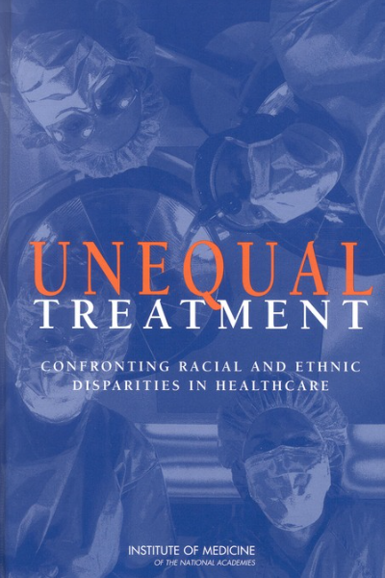
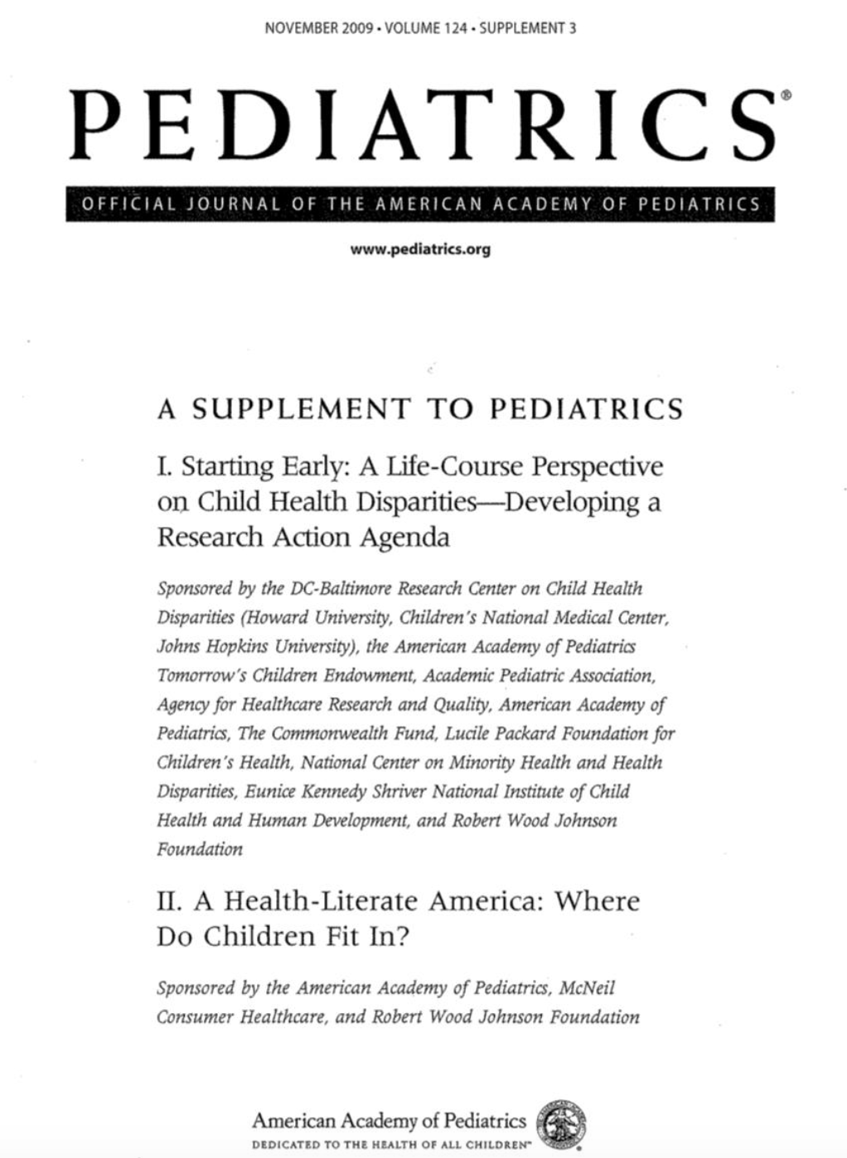
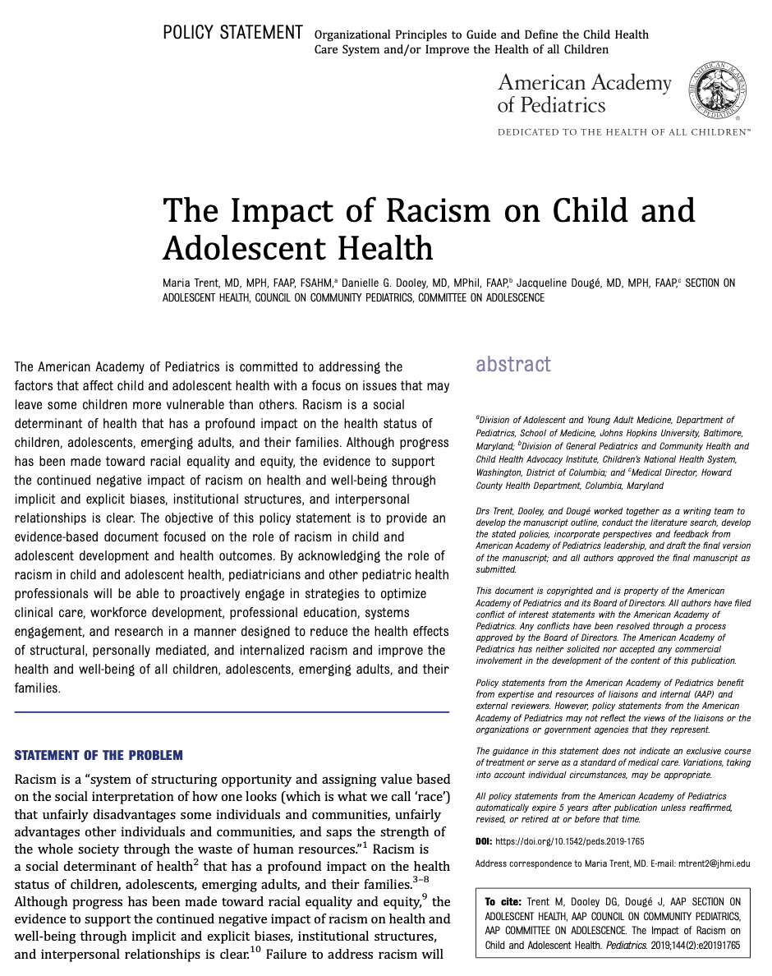
Impact of Racism on Health
2003 IOM Report
2009 Pediatrics Supplement
2019 AAP Policy Statement
Notes:
Institute of Medicine (US) Committee on Understanding and Eliminating Racial and Ethnic Disparities in Health Care. Unequal Treatment: Confronting Racial and Ethnic Disparities in Health Care. Smedley BD, Stith AY, Nelson AR, editors. Washington (DC): National Academies Press (US); 2003. PMID: 25032386.; Trent M, Dooley DG, Dougé J; SECTION ON ADOLESCENT HEALTH; COUNCIL ON COMMUNITY PEDIATRICS; COMMITTEE ON ADOLESCENCE. The Impact of Racism on Child and Adolescent Health. Pediatrics. 2019 Aug;144(2):e20191765. doi: 10.1542/peds.2019-1765. PMID: 31358665.

Slide 28


Education Matters
How education impacts health:
Income opportunities and resources
  Healthier neighborhoods
Health knowledge and skills
Social and psychological factors
  sense of control, social standing, social networks
Black students face disproportionately harsher punishment than white students in public schools
  18% of preschool population but represent 48% of out-of-school suspensions.¹
  By 10yo, Black youth are viewed as older (~4.5yrs).²
  Black youth (10 – 17yo) make up 44% of the population in juvenile (in)justice system.³
1. Helping to Ensure Equal Access to Education. U.S. Department of Education’s Office of Civil Rights
2. Phillip A. Goff, Matthew C. Jackson et. al. The Essence of innocence: Consequences of Dehumanizing Black Children. Journal of Personality and Social Psychology 2014
3. The Sentencing Project: Black Disparities in Youth Incarceration (2015)
Notes:
Early work on social determinants of health and health disparities consistently discovered that education matters and is linked to health outcomes. This occurs by providing increasing income opportunities and resources including access to healthier neighborhoods, increasing health knowledge and skills, and improving psychosocial factors. Furthermore, it is well documented that there is a preschool to prison pipeline. Black students face disproportionately harsher punishment in school for non-violent, nuisance, and/or developmentally-appropriate behavior. Despite, black preschoolers making up only 18% of the preschool population, they represent 48% of suspensions. Similar disproportionality is seen with school-related arrests and incarceration of black youth. Many of these children have learning disabilities or trauma histories and would benefit from additional educational and counseling services. Instead, they are isolated, punished and pushed out.
Helping to Ensure Equal Access to Education. U.S. Department of Education’s Office of Civil Rights; 2. Phillip A. Goff, Matthew C. Jackson et. al. The Essence of innocence: Consequences of Dehumanizing Black Children. Journal of Personality and Social Psychology 2014; The Sentencing Project: Black Disparities in Youth Incarceration (2015)

Slide 29
The health & daily lives of minority youth in the US are shaped directly/indirectly by the racism they experience.
Majority of U.S. black and Latino adolescents (as young as 10–12 years old) report experiencing racism and/or discrimination (Only 8% of adolescents did not)
Exposure to police violence negatively affects the mental health of black youth and adults
Note: Also, keep in mind intersectionality for racial/ethnic groups, which is experiencing additional discrimination based on belonging to another disadvantaged group besides race
(e.g. gender, religion, disability, sexual and/or gender identity, national origin)
Kulis et al., 2009, J Health Soc Behav; Brody et al., 2006, Child Dev; Ang, 2020; Bor et al., 2018, Lancet
Notes:
And what we’ve learned is that the health & daily lives of racial and ethnic minority US youth are shaped directly or indirectly by the racism and discrimination they experience. A majority of US black and Latino adolescents as young as 10 years old report experiencing racism and/or discrimination while only 8% have not. Additionally, exposure to police violence such as watching videos of unarmed black men and women on social media has been found to negative affect the mental health of black youth as well as adult black Americans. Personally, I find the videos traumatic to watch and stressful. See I’m getting an increase in my heart rate right now just thinking about the videos. Now keep in mind when we discuss the experiences of our black patients the concept of intersectionality which is when you experience additional discrimination based on belonging to another disadvantaged group besides race. For example, I am both a black person and a woman and can experience discrimination related to both of my identities, that’s intersectionality.

Slide 30
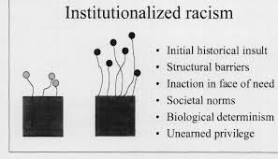
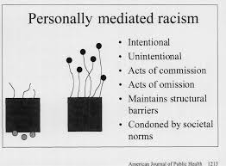
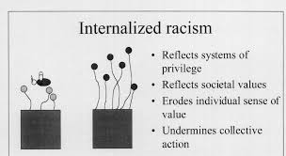
Levels of Racism
Jones CP. Levels of racism: a theoretic framework and a gardener's tale. Am J Public Health. 2000;90(8):1212-1215. doi:10.2105/ajph.90.8.1212
Notes:
It is normative, manifests as inherited (dis)advantage, and is embedded in institutions of practice and law, which negates the need for an identifiable perpetrator.
Structural: Zoning polices in black neighborhoods that prevent grocery stores from being developed.
Personally-mediated racism: doctor tells a family that they need to care about more about their health and stop being lazy so the patient can lose weight
Internalized: that black patient begins to believe that he is lazy and if he and other black people would put more effort into exercise that he'd be healthy

Slide 31



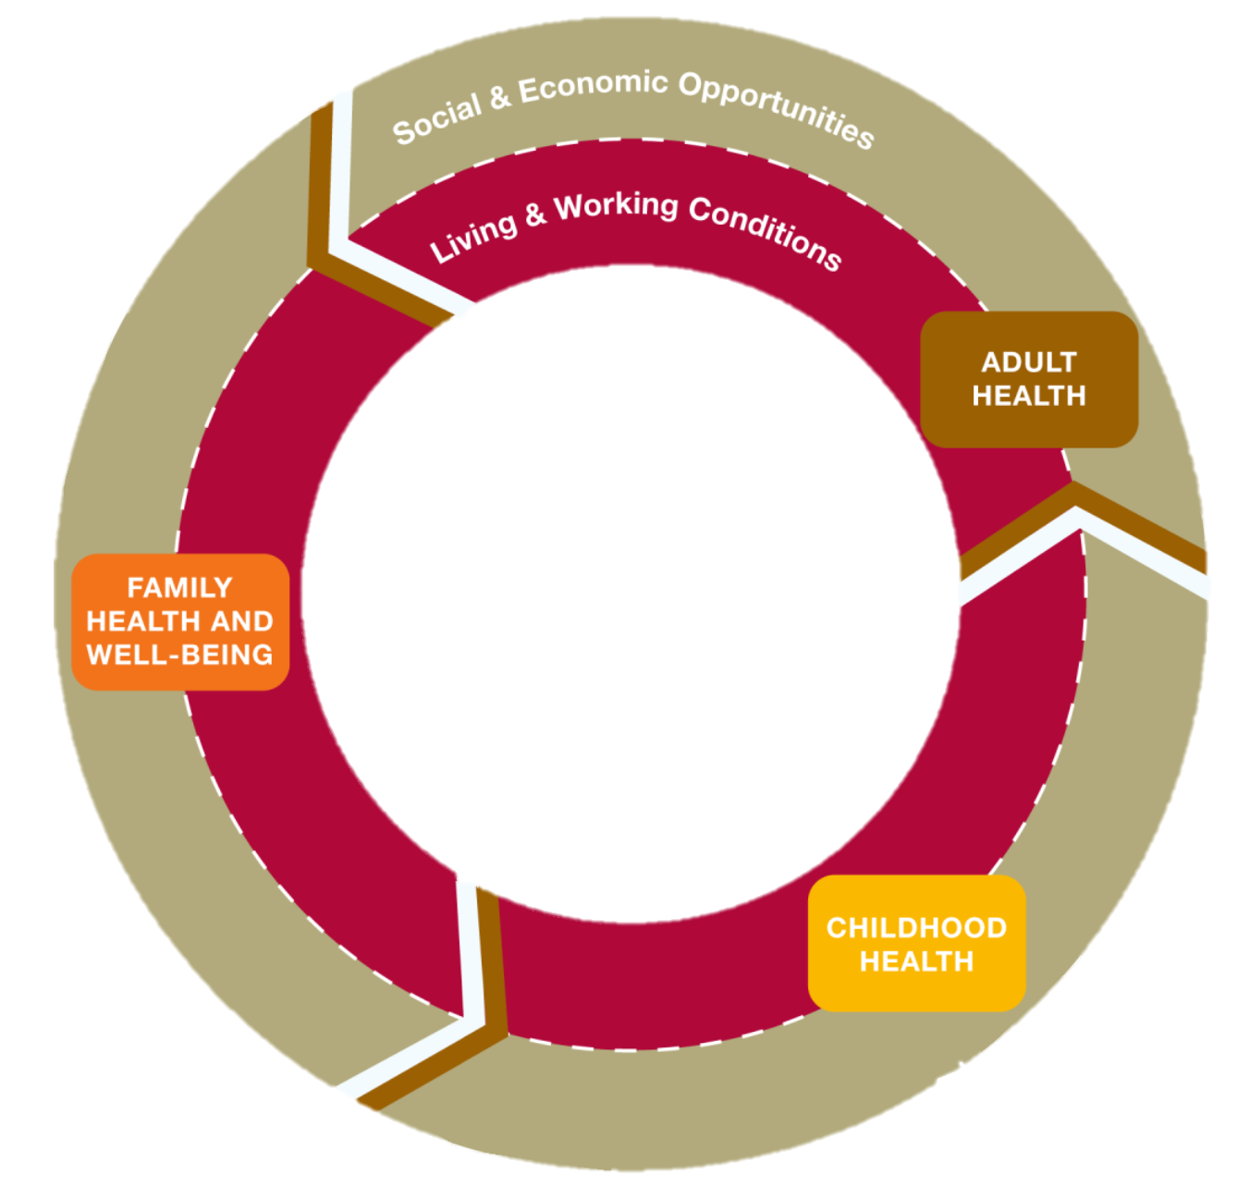
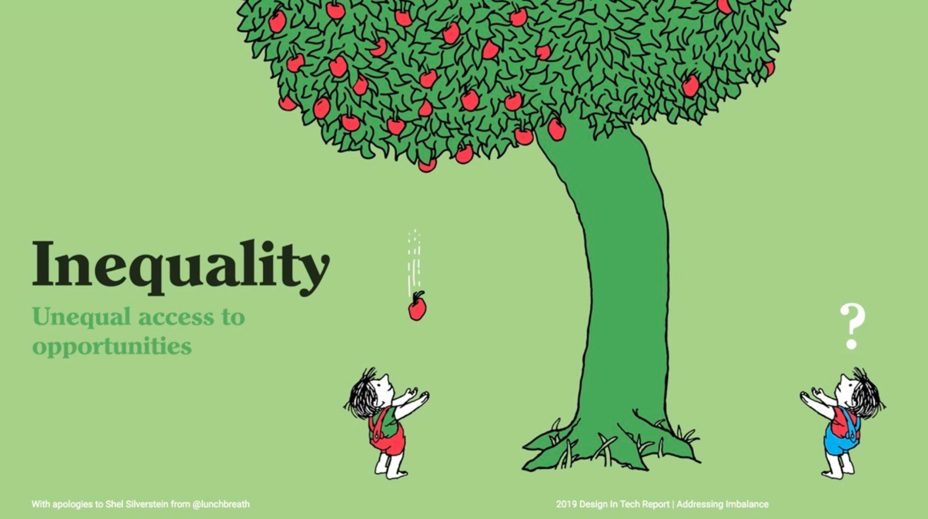
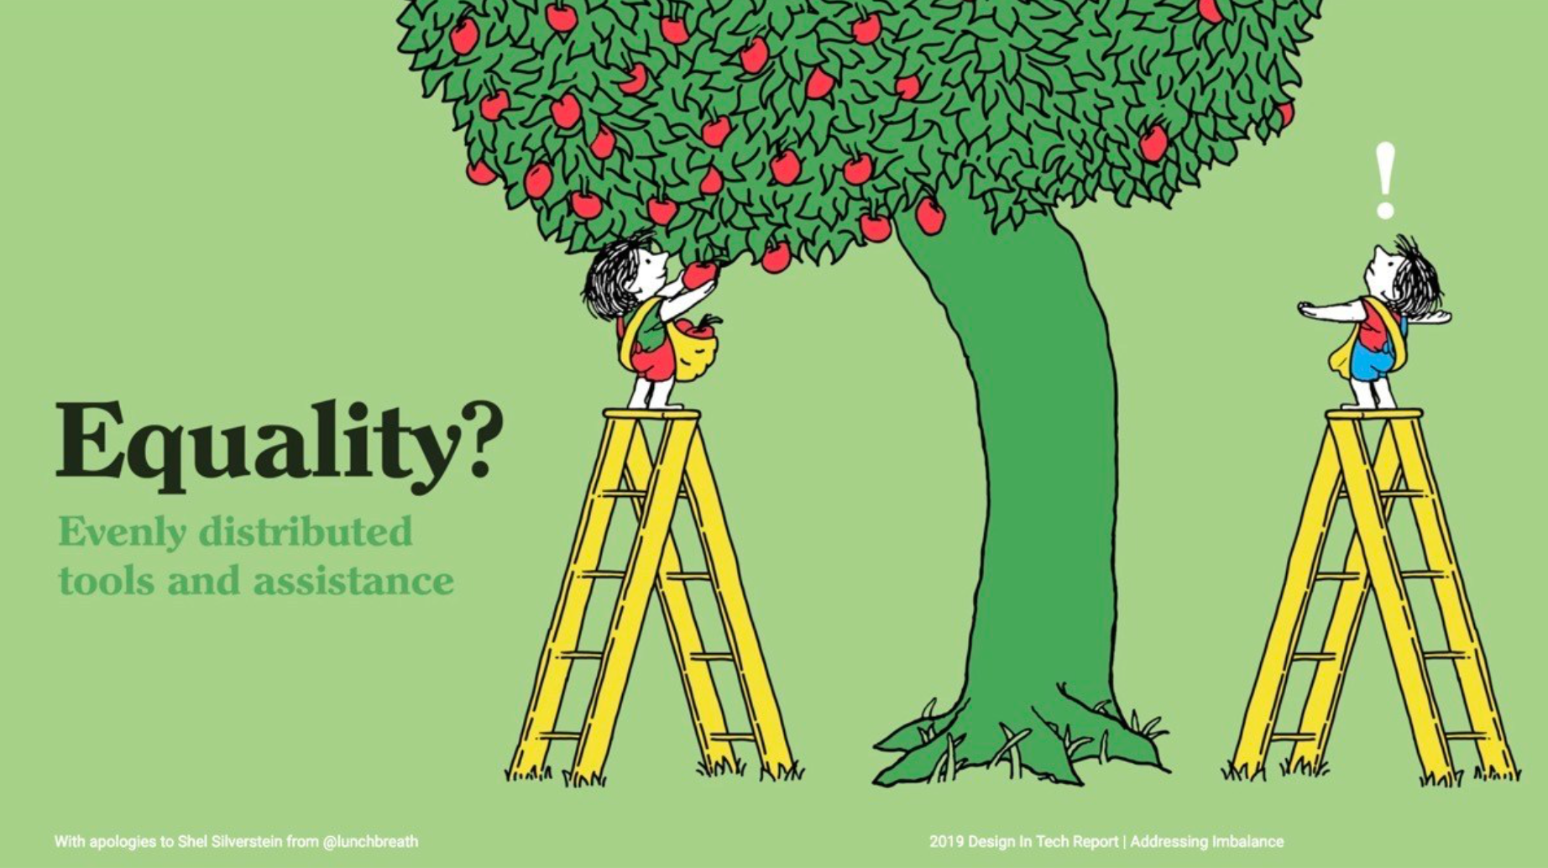
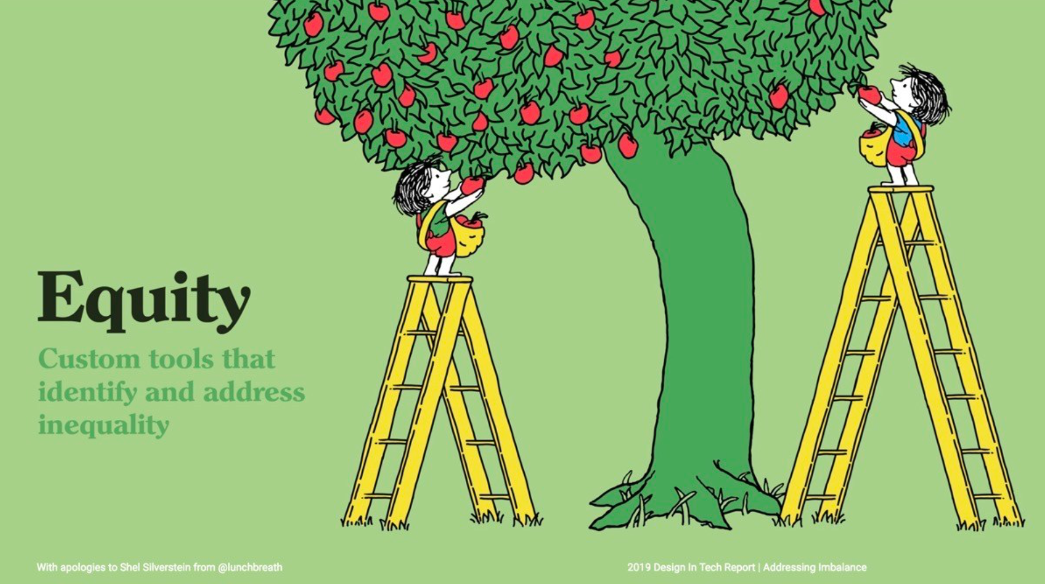
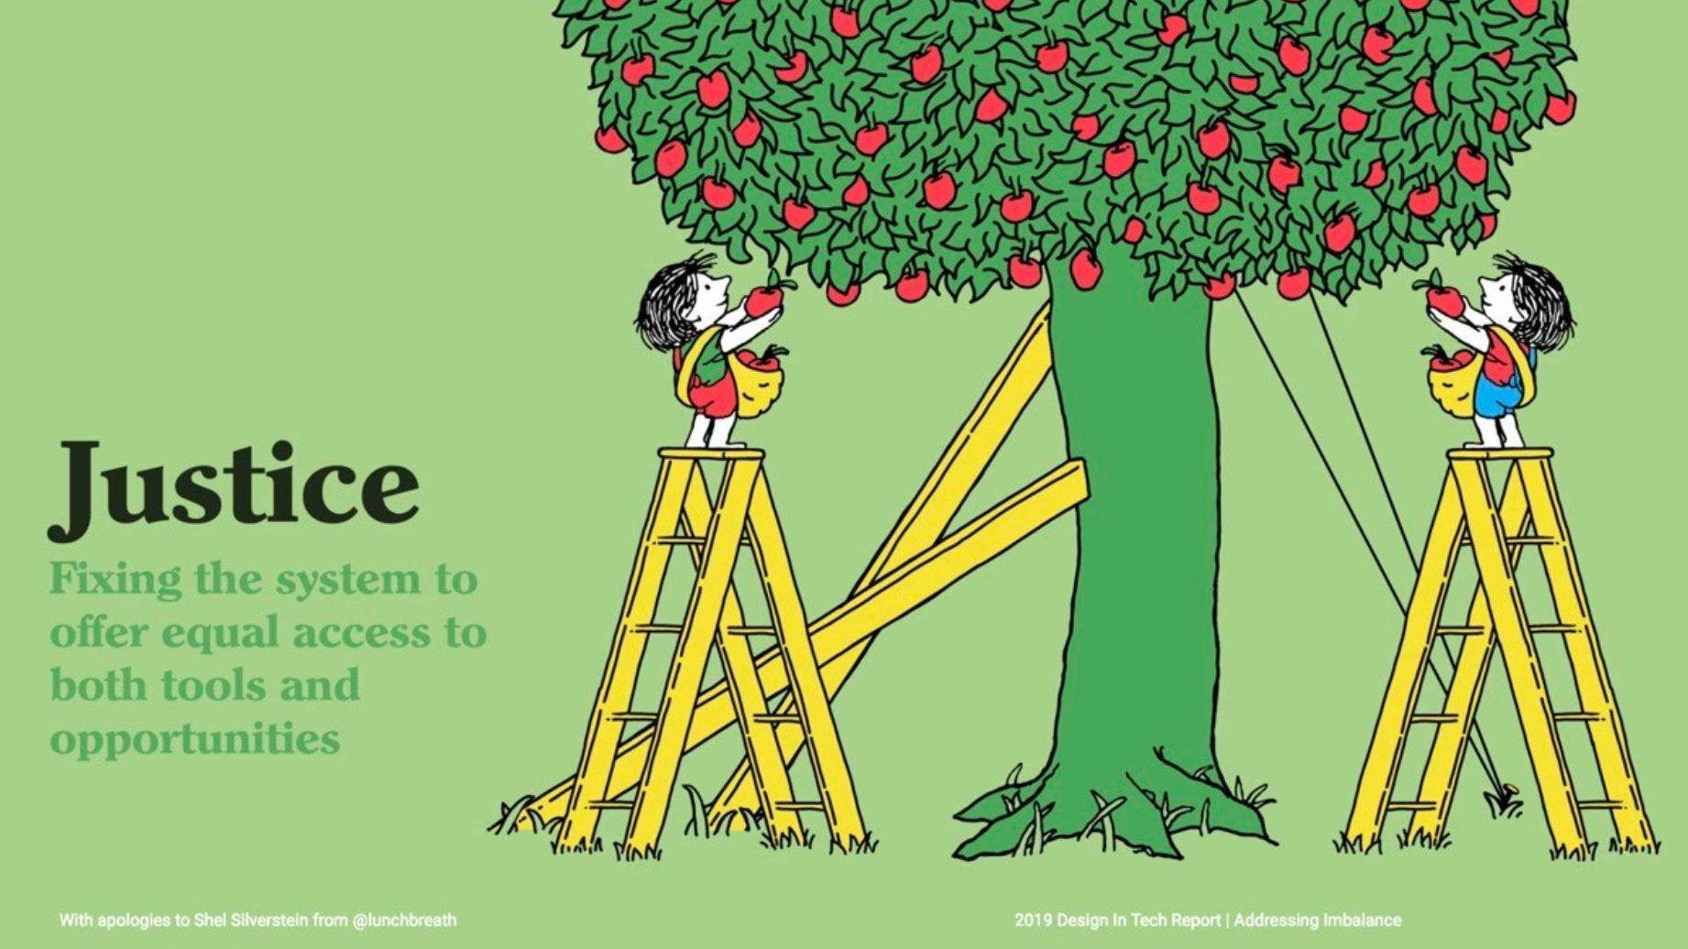
Levels of Racism
Infant Mortality, Low Birth Weight
Obesity, Diabetes, Hypertension
Access to
Addiction Treatment
Health Outcome & Disparity
Life Expectancy
racism
Historical Context
Historical Context
Historical Context
Notes:
Now going back to the very beginning of this talk, the iceberg theory of culture. Remember, we can only see 10% above the surface but 90% of that iceberg is hidden. So when we discuss health outcomes and health disparities we sometimes only see the statistics and the easily identifiable 10% of that health outcome. But in order to truly address health disparities we must dive deep down under the water and uncover everything below the surface. And under the surface of this particular health disparities iceberg is everything we just covered and more including racism, cycles of obstacles, multiple levels of influence for social determinants of health and inequity vs. equality concepts. This is why I did not start this talk with a bunch of statistics on specific disparities in pediatrics. We’ll get to that in the next section. But first…..

Slide 32
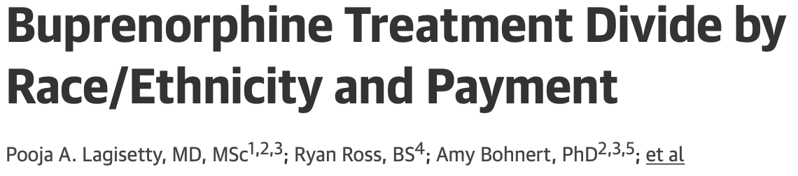
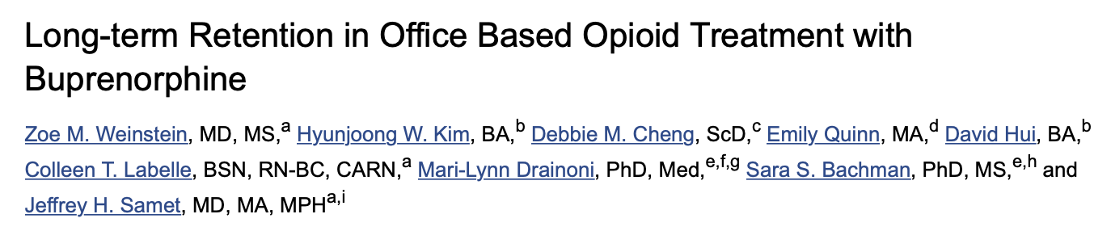
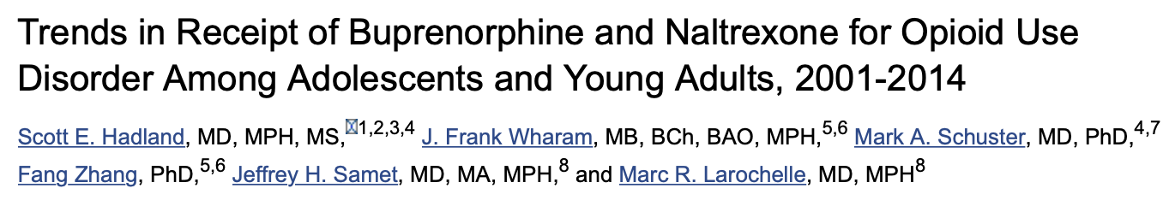
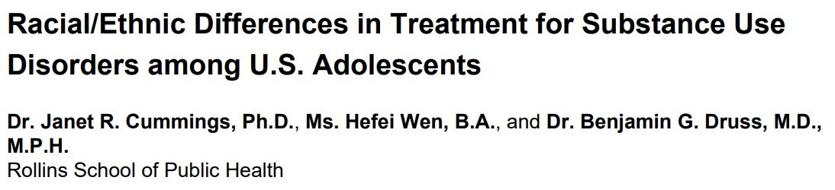
Access to Addiction Services Differs by Race/Gender
Receipt of Addiction Treatment After Opioid Overdose Among
Medicaid-Enrolled Adolescents and Young Adult
Rachel H Alinsky, Bonnie T Zima , Jonathan Rodean, Pamela A Matson, Marc R Larochelle,
Hoover Adger Jr, Sarah M Bagley, Scott E Hadland
Notes:
Lagisetty PA, Ross R, Bohnert A, Clay M, Maust DT. Buprenorphine Treatment Divide by Race/Ethnicity and Payment. JAMA Psychiatry. 2019 Sep 1;76(9):979-981. doi: 10.1001/jamapsychiatry.2019.0876. PMID: 31066881; PMCID: PMC6506898.; Weinstein ZM, Kim HW, Cheng DM, Quinn E, Hui D, Labelle CT, Drainoni ML, Bachman SS, Samet JH. Long-term retention in Office Based Opioid Treatment with buprenorphine. J Subst Abuse Treat. 2017 Mar;74:65-70. doi: 10.1016/j.jsat.2016.12.010. Epub 2016 Dec 30. PMID: 28132702; PMCID: PMC5312773.; Hadland SE, Wharam JF, Schuster MA, Zhang F, Samet JH, Larochelle MR. Trends in Receipt of Buprenorphine and Naltrexone for Opioid Use Disorder Among Adolescents and Young Adults, 2001-2014. JAMA Pediatr. 2017 Aug 1;171(8):747-755. doi: 10.1001/jamapediatrics.2017.0745. PMID: 28628701; PMCID: PMC5649381.; Alinsky RH, Zima BT, Rodean J, Matson PA, Larochelle MR, Adger H Jr, Bagley SM, Hadland SE. Receipt of Addiction Treatment After Opioid Overdose Among Medicaid-Enrolled Adolescents and Young Adults. JAMA Pediatr. 2020 Mar 1;174(3):e195183. doi: 10.1001/jamapediatrics.2019.5183. Epub 2020 Mar 2. PMID: 31905233; PMCID: PMC6990723.; Cummings JR, Wen H, Druss BG. Racial/ethnic differences in treatment for substance use disorders among U.S. adolescents. J Am Acad Child Adolesc Psychiatry. 2011;50(12):1265-1274. doi:10.1016/j.jaac.2011.09.006

Slide 33
Diving into Health Disparities
Where do we start? Strategies to improve it.

Slide 34
Diving into Health Disparities
“The only way to undo racism is to consistently identify and describe it –
and then dismantle it.”
                Ibram X. Kendi
Author of How to Be an Antiracist
Notes:
Well, the only way to undo racism is to consistently identify and describe it and then dismantle it.

Slide 35
Dismantle racism:
Well, how do I do that?
Notes:
Well, how do I do that?

Slide 36
Becoming an Antiracist in Health Care
Identify
(Diagnose)
Identify the social determinants of health and racial inequities that impact your specific patient population
Describe
(Work Up)
Describe those social determinants and inequities by:
1) Asking patients, 2) Creating community advisory boards, 3) Conducting needs assessments
Interrupt (Treatment Plan)
Interrupting these inequities and biases by:
1) Creating/revising processes and policies that don’t exacerbate inequities, 2) Examining one’s own biases
Notes:
I like to break down becoming an antiracist into 3 steps as Ibram Kendi states. Let’s take the example of the late patient. You want to first identify the social determinants of health and racial inequities that impact your specific patient population. Remember to go deep and think of the various levels of racism and influences that live below the surface. So you’ve identified an issue with transportation due to where your patient lives. So then you want to describe what is occurring and what those social determinants and inequities are by asking your patients, creating community advisory boards, and/or conducting needs assessments. You may find out that it takes your patient 3 bus lines to get to your office because they cannot afford a car and it’s 3 bus lines because they live in a transportation desert neighborhood. Then you want to interrupt these inequities and biases by creating or revising processes and policies that don’t exacerbate inequities and examine your own biases. So when you create your late policy are you disproportionately penalizing patients of color and maybe you make the automatic assumption that your black patients don’t care about being healthy and don’t respect your time and that’s why they’re late, when really there are obstacles that make it harder to come on time. Alternatively, our implicit bias may have impacted our non verbal or verbal interaction with our patient and given this previous bad experience connecting with their provider, they may not want to seek care as readily. This not a character judgement on anyone, we all have implicit or unconscious biases but they do impact our interactions with patients, result in unfavorable or favorable judgments, and we must learn to interrupt these biases. I don’t have time to do implicit bias training in this presentation but so I strongly encourage people to engage in this training.

Slide 37
Becoming an ally within systems
Education
Employment
Physical Environment
Social Environment
Transportation Systems
Housing
Income & Wealth
Health Care System
Notes:
So when we are doing this work of identifying and describing underlying racism and its effect on health, we should become allies within systems. And there is a clear distinction between trying to be a savior vs being an ally. The savior believes he or she has to solve the problem alone for the marginalized group and therefore, does not solicit the thoughts, feelings, suggestions, or ideas from others. On contrast, the ally works with the marginalized group to hear their voice, thoughts, and opinions and then uses his/her privilege to ensure those voices are heard and are a part of the improvement process.

Slide 38
Adverse Childhood Experiences (ACEs)
“Racism is an adverse childhood experience & core social determinant of health that is a driver of health inequities.”
Trent et al., 2019. Pediatrics
Notes:
I hope that I have convinced you that racism is a core social determinant of health that is a driver of health inequities. Accordingly, pediatrics should be at the forefront of addressing racism as a core social determinant, especially since this affects the lifecourse and as pediatricians our work relies on impacting the lifecourse.

Slide 39

Clinical Case
15-year-old Hispanic girl with Type I Diabetes
Multiple hospitalizations for DKA
History of non-compliance
Consult to adolescent medicine – talk to the patient about medication compliance and importance of taking her medications.
Notes:
In my role as a new primary care provider and adolescent health specialist in the department of pediatrics, I inherited a 10-year-old patient from a departing Endocrinologist who had insulin dependent diabetes. He had a stack of hospital records that was a tall as me. He had an interesting history of multiple admissions to the hospital and despite that fact of his multiple admissions, everyone in the institution was enamored by him. He was engaging and bright and seemed to have a lot going on for himself. As his primary care provider, my role was to fix him. I have since learned that I cannot, and it is not my role to fix anybody. This is the fallacy of the heuristic of the medical model that teaches us that when we identify a problem that it is our job to fix it; and to fix it right now. I have learned that the only ones who can actually do that, are my patients and/or their families. However, my initial assessment as his primary care provider was that he simply did not know enough about diabetes, so I sent him and his family off to a one-week residential diabetes education experience. I assumed that I had discovered the royal fix for this patient, and all seemed well for about the next 3-6 months. Then, he was back in the hospital admitted with DKA. Over the next several months he had several admissions and I was feeling like a total failure. Another 3-4 months went by and now he was admitted to the with a drastically new and different picture. He was admitted with seizures and documented hypoglycemia and a blood sugar of <20. He was seen by Neurology and Endocrinology and a bunch of other specialists and had a lot of fancy studies and imaging. They all had interesting theories in the etiology, but no one had any answers to the puzzle. So, when one is stuck, and it is not clear what you are dealing with, what are we taught to do? Yes, start at the beginning and take a good history.
So, I sat down with the patient and took a complete history including a family history and social history and used my curiosity to learn about the patient as an individual within his community and through the inquiry out popped the secret. Any Guesses as to the secret?
The patient had been diagnosed with DM at the age of two and the mother was the person who administered the insulin. The problem was that the mother had an interesting condition called alcoholism that none of the previous care providers, nor myself, were aware of. And depending on how intoxicated she was and how blurred her vision was she either pulled up too much or too little insulin. So as the pediatrician, I intervened, with the mother on behalf of the child and assisted the mother in getting into treatment for her alcohol use disorder. I subsequently had the opportunity to follow this same patient for an additional 10 years and over the next 10 years of following this young man how many admissions do you think that he had to the hospital? He had not a single admission to the hospital. My interventions were to monitor his blood sugar and if there seemed to be an alteration in his control that was a signal to touch base with his mother to ensure that she had the support network that she needed to maintain her sobriety and recovery. My lesson from this was that this patient like so many other children was suffering in silence and that in order to be a good physician, I needed to know more about the disease of addiction, substance use and substance use disorders.

Slide 40
Adolescent
Run away
Drug user
Mother is an addict
Black & Brown
Doing ”adult” things
Unhealthy
Older than appears
Made her own decisions
Poor
Lazy
Risky behavior
Low health literacy
Incarcerated
Abused
Hot mess/train wreck
Defiant
Hard to place adolescent in new home
Too complicated of a case
Non-compliant
Adapted from Camille Robinson, MD, MPH

Slide 41
Racial/Ethnic Differences in Treatment for Substance Use Disorders Among U.S. Adolescents
Janet R. Cummings, PhD, Hefei Wen, BA, Benjamin G. Druss, MD, MPH, J Am Acad Ch & Adol Psychiatry, 2011
Low treatment rates for SUD found among all adolescents, with blacks and Hispanics having the lowest treatment rates across all racial/ethnic groups.

Slide 42
Explaining Racial/Ethnic Differences in Adolescent Substance Abuse Treatment Completion in the United States:
A Decomposition Analysis; Saloner B, Carson N, Le Cook B, J Adol Health, 2014
Black and Hispanic youth were significantly less likely than whites to complete Tx for both ETOH and THC. Completion rates were similar for whites, Native Americans, and Asian Americans.
Differences in predictor variables explained 12.7% of the black-white ETOH Tx gap and 7.6% of the THC Tx gap.
Factors related to social context are likely to be important contributors to white-minority differences in addiction Tx completion, particularly for Hispanic youth.
Increased Medicaid funding, coupled with culturally tailored services, could be particularly beneficial.
Unadjusted treatment completion rates by race/ethnicity for alcohol and marijuana treatment
Notes:
Heavy alcohol and drug use beginning in adolescence substantially increases risk of poor health, criminal activity, and incarceration in adulthood.[1,2] Although black and Hispanic adolescents abuse substances at rates comparable to (or lower than) non-Hispanic whites (hereafter “whites”),[3,4] they are disproportionately likely to experience arrests and future health problems because of substance abuse.[5,6] Greater risk for negative consequences among black and Hispanic youth partially stems from greater exposure to social stressors such as poverty and greater contact with law enforcement.[7,8]
Poor access to the substance abuse treatment system may be another important contributor to worse outcomes for minority youth with addiction disorders. One recent study finds that, compared to whites, black and Hispanic adolescents with substance use disorders are significantly less likely to utilize treatment in both clinical and self-help settings.[10] Generally, when minorities achieve access to the system, they are less likely to receive services with a substance abuse treatment professional or in a residential setting.[11]
We examined racial/ethnic differences in alcohol and marijuana treatment among youth receiving treatment from publicly-funded providers located in MSAs. We found that more than one third of white youth in our sample did not complete treatment for either substance. Non-completion rates were significantly higher for black and Hispanic youth: about half did not complete treatment for each substance
Black youth were at higher risk for terminating treatment because of reported noncompliance with treatment and because of incarceration, which could reflect interpersonal or legal difficulties not easily measured by our study variables. Black youth were also more likely to enter marijuana treatment through criminal justice referrals, likely indicating higher rates of mandated treatment. Incarceration may therefore be a consequence of noncompliance with court ordered treatment.

Slide 43
Adolescent-Serving Addiction Treatment Facilities in the United States and the Availability of Medications for Opioid Use Disorder
RH Alinsky, SE Hadland, PA Matson, M Cerda, B Saloner, J Adol Health, 67: 2020.
Cross-sectional study of 2017 of National Survey of Substance Abuse Treatment Services facilities classified by whether they offer adolescent services.
Among 13, 585 US addiction treatment facilities, 26% offered adolescent programs.
Adolescent serving facilities were half as likely to offer maintenance MOUD as adult-focused facilities, which was offered at 23.1% of adolescent vs. 36% of adult-focused facilities.
Among adolescent-serving facilities characteris-tics associated with increased odds of offering maintenance MOUD were non-profit status, hosp. affiliation, accepting private insurance, accreditation, NE location, inpatient services.

Slide 44
Receipt of Addiction treatment After Opioid Overdose
Among Medicaid Enrolled Adolescent and Young Adults
RH Alinsky, BT Zima, J Rodean, PA Matson, MR LaRochelle, H Adger, SM Bagley, SE Hadland, JAMA Peds, 2020
Sociodemographic and Clinical Characteristics of 3606 Youth with Opioid Overdose by Receipt of Tx < 30 days of OD
Retrospective cohort study, 2009-15, Medicaid enrolled youth 13-22 years old.
26.4 % heroin OD; 74% other opioid OD.
Of 3606 with opioid OD and enrollment >30 days after OD, 68.9% received no addiction treatment, only 29.3% received behavioral health services and only 1.9% received pharmacotherapy.
There was a marked racial/ethnic disparity; only 1 black or Hispanic youth in the study received pharmacotherapy.

Slide 45
Health Disparities in Drug- and Alcohol-Use Disorders:
A 12-Year Longitudinal Study of Youths After Detention
LJ Welty, AJ Harrison, KM Abram, ND Olson, DA Aaby, KP McCoy, JJ Washburn, and LA Teplin, AHPH, May, 2016
Objectives: To examine sex and racial/ethnic differences in the prevalence of 9 different SUDs in youths during the 12 years after detention.
Methods: Data from the NW Juvenile Project, a prospective longitudinal study of 1,829 youths randomly sampled from detention in Chicago, IL, starting in 1995 and re-interviewed up to 9 times in the community or correctional facilities through 2011.
Results. By median age 28 years, 91.3% of males and 78.5% of females had ever had an SUD. At most follow-ups, males had greater odds of ETOH- and THC-use disorders. SUDs were most prevalent among non-Hispanic Whites, followed by Hispanics, then African Americans (e.g., compared with African Americans, non-Hispanic Whites had 32.1 times the odds of cocaine-use disorder.

Slide 46
Health Disparities in Drug- and Alcohol-Use Disorders:
A 12-Year Longitudinal Study of Youths After Detention
LJ Welty, AJ Harrison, KM Abram, ND Olson, DA Aaby, KP McCoy, JJ Washburn, and LA Teplin, AHPH, May, 2016
Substance use is a significant problem among youth in the juvenile justice system.
Irrespective of sex or race/ethnicity, SUDs are the most common psychiatric disorders among delinquent youth.
After detention, SUDs present a continuing challenge for the community mental health system.
Implications:
  Address-- as a health disparity-- the disproportionate incarceration of African Americans for drug offenses.
  SUD has far greater consequences for racial/ethnic minorities.
  Need to improve preventive interventions, services during incarcerations and care after release from detention.

Slide 47
Many Rivers to Cross: Critical Challenges and Overarching Goals for the African American Behavioral Health Center of Excellence
Pamela Woll, MA, CPS, Morehouse School of Medicine
Four areas of particular challenge stand out:
1. Systemic inequities that block many minoritized populations from sufficient access and engagement in evidence-based treatment;
2. scarcity and insufficient use of culturally appropriate evidence-based and promising interventions for patients of color;
3. minimal workforce development for mental health clinicians on the social determinants of health, and subjects such as implicit bias, cultural humility, and other factors that impede high-quality care for minoritized populations;
4. the difficulty of reaching the full range of providers with the training and resources needed to address the variety of circumstances and challenges affecting this highly diverse population.

Slide 48
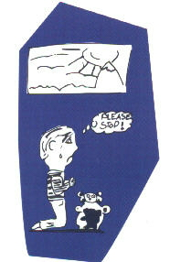
Practical Issues: What is our role as health care professionals and child health advocates?

Slide 49

A Little Bit of Caring Goes a Long Way
Drug use is a preventable behavior.
Drug Addiction is a treatable disease.
Partnership for a Drug-Free America

Slide 50
References:
  Slide 8: SAMHSA, Center for Behavioral Health Statistics and Quality, National Surveys on Drug Use and Health (NSDUHs), 2009 to 2014.
  Slide 9 – 10: B F Grant, AJPH; 90 (1):112-115; 2000
  Slide 11: Volkow ND, Koob GF, McLellan AT. Neurobiologic Advances from the Brain Disease Model of Addiction. N Engl J Med. 2016;374(4):363-371. doi:10.1056/NEJMra1511480
  Slide 13 – 15 Lipari RN, Van Horn SL. Children Living with Parents Who Have a Substance Use Disorder. 2017 Aug 24. In: The CBHSQ Report. Rockville (MD): Substance Abuse and Mental Health Services Administration (US); 2013– PMID: 29144715.
  Slide 16: Center for Substance Abuse Treatment. Substance Abuse Treatment and Family Therapy. Rockville (MD): Substance Abuse and Mental Health Services Administration (US); 2004. (Treatment Improvement Protocol (TIP) Series, No. 39.) Chapter 1 Substance Abuse Treatment and Family Therapy. Available from: https://www.ncbi.nlm.nih.gov/books/NBK64269/
  Slide 19: Kendi, I. (2019). How to be an antiracist. Bodley Head.; Jones CP. Levels of racism: a theoretic framework and a gardener's tale. Am J Public Health. 2000 Aug;90(8):1212-5. doi: 10.2105/ajph.90.8.1212. PMID: 10936998; PMCID: PMC1446334.
  Slide 21 – 25: Institute of Medicine (US) Committee for the Substance Abuse Coverage Study; Gerstein DR, Harwood HJ, editors. Treating Drug Problems: Volume 2: Commissioned Papers on Historical, Institutional, and Economic Contexts of Drug Treatment. Washington (DC): National Academies Press (US); 1992. A Century of American Narcotic Policy. Available from: https://www.ncbi.nlm.nih.gov/books/NBK234755/; Rothstein, R. (2018). The color of law. Liveright Publishing Corporation.
  Slide 27, 34, 38: Institute of Medicine (US) Committee on Understanding and Eliminating Racial and Ethnic Disparities in Health Care. Unequal Treatment: Confronting Racial and Ethnic Disparities in Health Care. Smedley BD, Stith AY, Nelson AR, editors. Washington (DC): National Academies Press (US); 2003. PMID: 25032386.; Trent M, Dooley DG, Dougé J; SECTION ON ADOLESCENT HEALTH; COUNCIL ON COMMUNITY PEDIATRICS; COMMITTEE ON ADOLESCENCE. The Impact of Racism on Child and Adolescent Health. Pediatrics. 2019 Aug;144(2):e20191765. doi: 10.1542/peds.2019-1765. PMID: 31358665.
  Slide 28: Helping to Ensure Equal Access to Education. U.S. Department of Education’s Office of Civil Rights; 2. Phillip A. Goff, Matthew C. Jackson et. al. The Essence of innocence: Consequences of Dehumanizing Black Children. Journal of Personality and Social Psychology 2014; The Sentencing Project: Black Disparities in Youth Incarceration (2015)
  Slide 29: Kulis et al., 2009, J Health Soc Behav; Brody et al., 2006, Child Dev; Ang, 2020; Bor et al., 2018, Lancet
  Slide 30: Jones CP. Levels of racism: a theoretic framework and a gardener's tale. Am J Public Health. 2000;90(8):1212-1215. doi:10.2105/ajph.90.8.1212
  Slide 32, 41, 44 : Lagisetty PA, Ross R, Bohnert A, Clay M, Maust DT. Buprenorphine Treatment Divide by Race/Ethnicity and Payment. JAMA Psychiatry. 2019 Sep 1;76(9):979-981. doi: 10.1001/jamapsychiatry.2019.0876.; Weinstein ZM, Kim HW, Cheng DM, Quinn E, Hui D, Labelle CT, Drainoni ML, Bachman SS, Samet JH. Long-term retention in Office Based Opioid Treatment with buprenorphine. J Subst Abuse Treat. 2017 Mar;74:65-70..; Hadland SE, Wharam JF, Schuster MA, Zhang F, Samet JH, Larochelle MR. Trends in Receipt of Buprenorphine and Naltrexone for Opioid Use Disorder Among Adolescents and Young Adults, 2001-2014. JAMA Pediatr. 2017 Aug 1;171(8):747-755..; Alinsky RH, Zima BT, Rodean J, Matson PA, Larochelle MR, Adger H Jr, Bagley SM, Hadland SE. Receipt of Addiction Treatment After Opioid Overdose Among Medicaid-Enrolled Adolescents and Young Adults. JAMA Pediatr. 2020 Mar 1;174(3):e195183..; Cummings JR, Wen H, Druss BG. Racial/ethnic differences in treatment for substance use disorders among U.S. adolescents. J Am Acad Child Adolesc Psychiatry. 2011;50(12):1265-1274
  Slide 42: Saloner B, Carson N, Lê Cook B. Explaining racial/ethnic differences in adolescent substance abuse treatment completion in the United States: a decomposition analysis. J Adolesc Health. 2014;54(6):646-653. doi:10.1016/j.jadohealth.2014.01.002
  Slide 43: Alinsky RH, Hadland SE, Matson PA, Cerda M, Saloner B. Adolescent-Serving Addiction Treatment Facilities in the United States and the Availability of Medications for Opioid Use Disorder. J Adolesc Health. 2020 Oct;67(4):542-549
  Slide 45 – 46: Welty LJ, Harrison AJ, Abram KM, Olson ND, Aaby DA, McCoy KP, Washburn JJ, Teplin LA. Health Disparities in Drug- and Alcohol-Use Disorders: A 12-Year Longitudinal Study of Youths After Detention. Am J Public Health. 2016 May;106(5):872-80.
  Slide 47: Many Rivers to Cross: Critical Challenges and Overarching Goals for the African American Behavioral Health Center of Excellence

Slide 51
Thank You
Kevin M. Simon, MD Child and Adolescent Psychiatry Fellow
Boston Children's Hospital, Addiction Medicine Fellow, Boston Children's Hospital, Clinical Fellow in Psychiatry Harvard Medical School
Hoover Adger, Jr., MD, MPH, MBA
Professor of Pediatrics, Division of Adolescent & Young Adult Medicine, Faculty Co-Leader, Sabin College, Johns Hopkins School of Medicine

Slide 52

Related Products & Resources
from the ATTC Network
CLAS Standards in Behavioral Health: Working with Youth and Adolescents (Recorded webinar)
Understanding Latino Youth Recovery: Issues, Assets and Creating Resiliency (Recorded webinar)
Adolescent Brain Maturation and Health: Intersections on the Developmental Highway
  Recorded presentation
  Handouts
Effects on Marijuana Use on Developing Adolescents (Recorded webinar)
Vaping Overview and CATCH My Breath Program (Recorded webinar)
Vaping 2: Education vs Punishment Using Deferred Citation (Recorded webinar)
Understanding Suicide Part 2 Adolescents and the Changing Brain (Recorded webinar)
attcnetwork.org/centers/global-attc/tay-webinar-series
Notes:
To augment the information provided today, you can check out these additional resources from the ATTC and PTTC Networks.

Slide 53

Related Products & Resources
from the PTTC Network
Underage Alcohol Use: An Overview of Data and Strategies (Recorded webinar)
Youth Opioid Addiction: What Preventionists Need to Know (Recorded webinar)
Selecting and Implementing Evidence-Based Practices to Address Substance Misuse Among Young Adults: Webinar on SAMHSA’s Resource Guide
Preventing Youth Vaping (Webinar Series) Part 1 of 2: The Extent and Risk Factors for Youth Vaping (Recorded webinar)
Preventing Youth Vaping Part 2 of 2: Policy Recommendations and Promising Practices for Addressing Youth Vaping (Recorded webinar)
The Benefits of Engaging Youth in Communities: Insights and Evidence from Developmental Science (Recorded webinar)
Vaping and LGBTQ Youth (Recorded webinar)
Informing Prevention 6-Part Webinar Series on Adolescents: Mountain Plains PTTC
Adolescent SBIRT Pocket Card
attcnetwork.org/centers/global-attc/tay-webinar-series

Slide 54



Keep in Touch with
the AMERSA Network
For more information about AMERSA visit: www.amersa.org
Join our mailing list: https://amersa.org/contact-us/
@AMERSA_tweets
@AMERSA2021
amersa.org/resources/tay-webinar-series/
Notes:
You can also keep in touch with ATTC, NORC and AMERSA via their newsletters and social media. Sign up now for monthly emails and follow them on Twitter and Facebook.

Slide 55
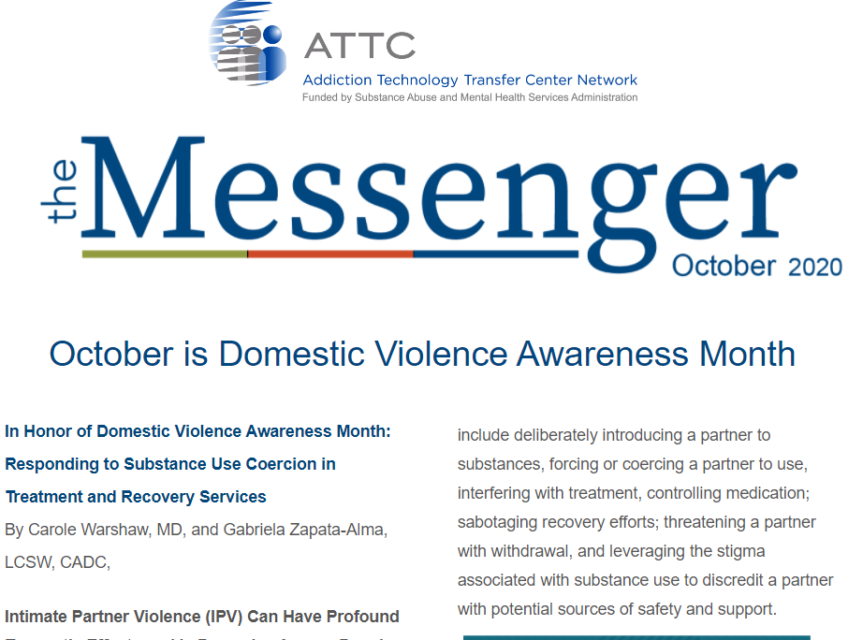
Keep in Touch with
the ATTC Network
ATTC Network Office publishes the Messenger monthly
  Subscribe: https://attcnetwork.org/centers/global-attc/subscribe-attc-messenger
@ATTCnetwork
@attcNetwork
attcnetwork.org/centers/global-attc/tay-webinar-series

Slide 56
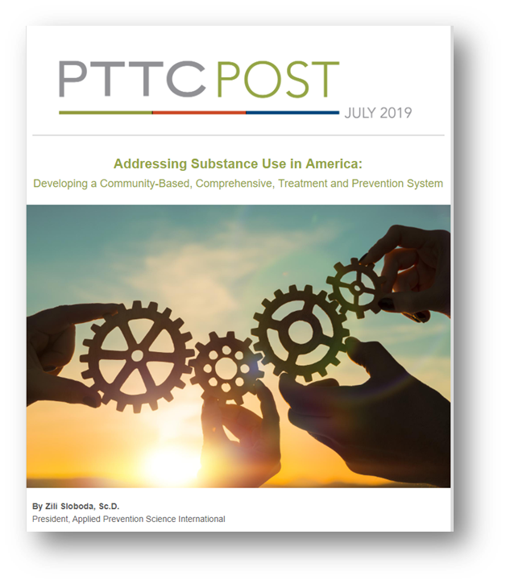
Keep In Touch with
the PTTC Network
PTTC Network Office publishes the PTTC POST monthly
  Subscribe:
  https://pttcnetwork.org/centers/global-pttc/pttc-subscription-page
@PTTCnetwork
@PreventionTTCnetwork
attcnetwork.org/centers/global-attc/tay-webinar-series

Slide 57
Substance Use Disorders:
Appreciating the Challenges of Minority Youth
Produced in Partnership by:
amersa.org/resources/tay-webinar-series/

